Slide 1
Engineering Management
Managing Research
and Development
Lecture 22,23,24

Slide 2
Objectives
• Explain product and technology life cycles.
• Describe the legal means to protect a person’s ideas.
• Discuss the nature of creativity.

Slide 3
Product and technology life cycles
A new product begins as an idea for the solution of a problem or the satisfaction of a need.
In nature only a few out of a hundred tadpoles survive to become frogs; in research only a few out of many research ideas will be vigorous enough to survive and will reach the right environment to mature into a successful product.
This cradle-to-grave sequence is known as the product life cycle .

Slide 4
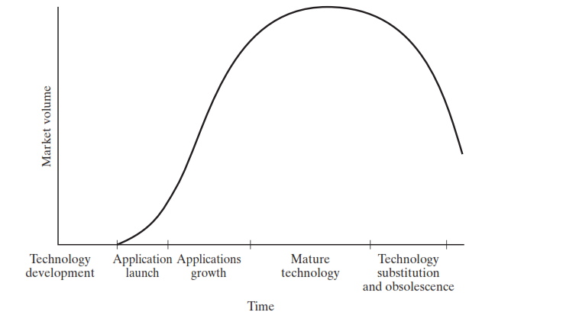
Technology Life Cycle

Slide 5
Nature of research and development
Research, both basic and applied, is systematic, intensive study directed toward fuller scientific knowledge of the subject studied.
Basic research: Research devoted to achieving a fuller knowledge or understanding, rather than a practical application, of the subject under study. [although when funded by commercial firms, it] may be in fields of present or potential interest to the company.
Applied research is directed toward the practical application of knowledge, which for industry means the discovery of new scientific knowledge that has specific commercial objectives with respect to either products or processes.
Development is the systematic use of scientific knowledge directed toward the production of useful materials, devices, systems, or methods, including design and development of prototypes and processes.

Slide 6
Selecting R&D Projects
Need for selection:
Three prototypes for detailed physical and market testing, resulting in
Two products committed to full-scale production and marketing.
One product should be real market success.

Slide 7
Selecting R&D Projects
Initial screening
1. Technical factors (availability of needed skills and facilities; probability of technical success)
2. Research direction and balance (compatibility with research goals and desired research
balance)
3. Timing (of R&D and market development relative to the competition)
4. Stability (of the potential market to economic changes and difficulty of substitution)
5. Position factor (relative to other product lines and raw materials)
6. Market growth factors for the product
7. Marketability and compatibility with current marketing goals, distribution methods, and
customer makeup
8. Producibility with current production facilities and manpower
9. Financial factors (expected investment need and rate of return from it)
10. Patentability and the need for continuing defensive research

Slide 8
Making R&D organizations successful
R&D and business strategy
1. Base technologies. These are the technologies that a firm must master to be an effective competitor in its chosen product-market mix. They are necessary, but not sufficient.
2. Key technologies These technologies provide competitive advantage. They may permit the producer to embed differentiating features or functions in the product or to attain greater efficiencies in the production process.
3. Pacing technologies. These technologies could become tomorrow’s key technologies. Not every participant in an industry can afford to invest in pacing technologies; this is typically what differentiates the leaders (who do) from the followers (who do not).

Slide 9
Evaluating R&D effectiveness
1. Ratio of research costs to profits
2. Percentage of total earnings due to new products
3. Share of market due to new products (usually computed as the volume of sales from a firm’s new products in a specific product market to the total sales available from that market, which confounds the measure by including marketing proficiency as well)
4. Research costs related to increases in sales
5. Research costs to ratio of new and old sales
6. Research costs per employee
7. Ratio of research costs to overhead expenses such as administrative and selling costs
8. Cash flows (continuing evaluation of the pattern of outflows for research expense and
actual and projected inflows from resulting revenue)
9. Research audits, including indicators of administrative and technical objectives such as
costs, time, completion dates, probability of technical success, probability of commercial
success, expected market share, expected profits, expected return on investment, design,
and development. Blake provides a checklist of questions to ask in such an audit.
10. Weighted averages of costs and objectives (a measure of the extent the average R&D dollar
contributed toward objectives with weights on a scale, such as 0.0 equals project badly
missed objectives to 3.0 equals project far exceeded objectives)
11. Project profiles (a more complex weighted scoring of each project, using criteria such as
those in the research audits.)

Slide 10
Creativity, innovation, entrepreneurship
Nature of creativity
The creative Process
Brainstorming and other techniques for creativity

Slide 11
Characteristics of creative People
1. Self-confidence and independence. Creative people seem to be self-confident, self-sufficient,
emotionally stable, and able to tolerate ambiguity. They are independent in thought and
action and tend to reduce group pressures for conformity and rules and regulations that do
not make sense.
2. Curiosity. They have a drive for knowledge about how or why things work, are good observers
with good memories, and build
a broad knowledge
about a wide range of subjects.
3. Approach to problems. Creative people are open-minded and uncritical in the early stages of
problem solving, generating many ideas. They enjoy abstract thinking and employ method,
precision, and exactness in their work. They concentrate intensively on problems that interest
them and resent interruptions to their concentration.
4. Some personal attributes. Creative people may be more comfortable with things than people,
have fewer close friends, and are not joiners. They have broad intellectual interests: They
enjoy intellectual games, practical jokes, creative writing, and are almost always attracted
by complexity.

